Slide 1
VIDYA JYOTHI INSTITUTE OF TECHNOLOGY
(Autonomous)
Lung Cancer Prediction Using CNN
Under the guidance of Dr. Masrath Parveen
Assistant Professor
Department of IT
By :Team 3
B.Ajay [21911A1209]
M.Anil [21911A1236]
M.Akash [21911A1238]

Slide 2
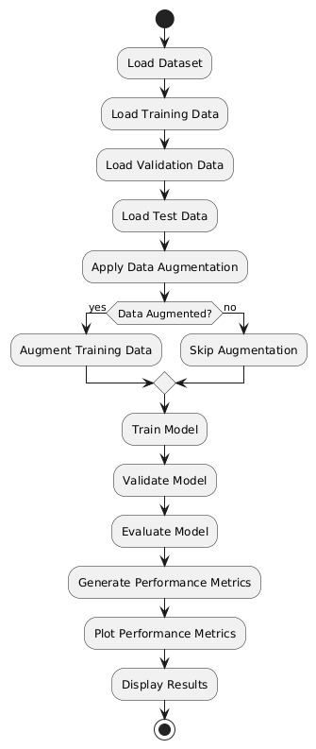
Design:
Activity Diagram :

Slide 3
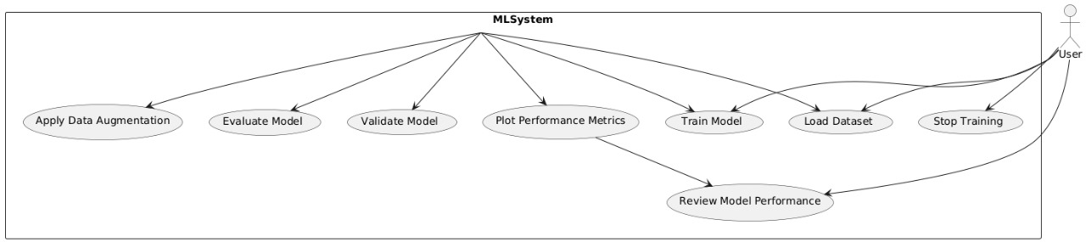
Design:
Use Case Diagram:

Slide 4
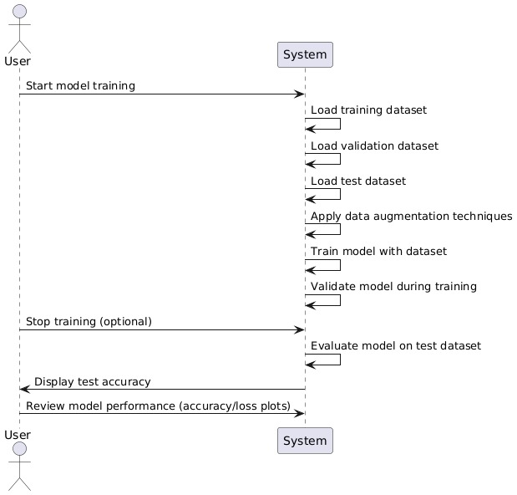
Design:
Sequence Diagram:

Slide 5
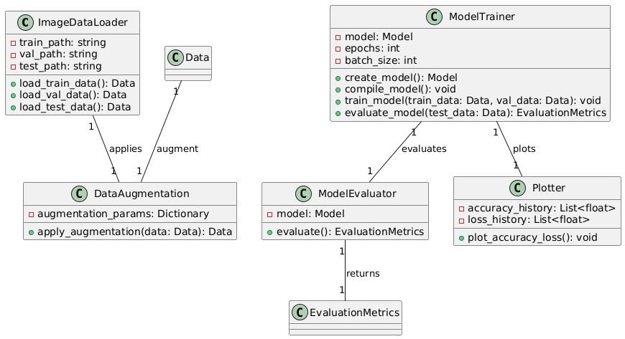
Design:
Class Diagram:

Slide 6
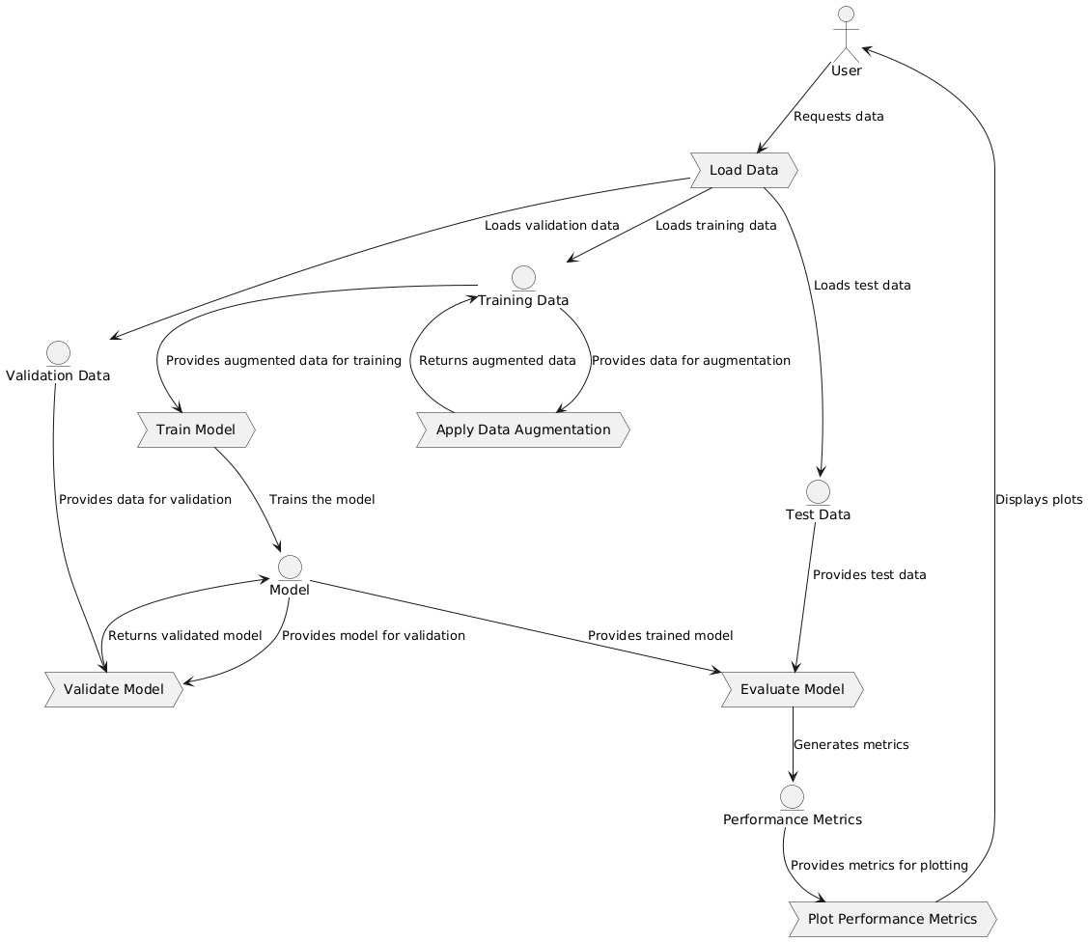
Design:
Data Flow Diagram:

Slide 7
Implementation Progress :
1.Dataset Collection & Preprocessing
Chest X-ray dataset has been collected from medical repositories.
Data cleaning, augmentation, and preprocessing (resizing, noise reduction, contrast enhancement) have been done.
2.Model Selection & Implementation
CNN architecture has been designed.
Transfer learning has been considered for improved accuracy. Initial testing with sample datasets has been conducted.
3.Training & Optimization
The CNN model has been trained on the dataset.
Hyperparameter tuning has been performed for better accuracy.

Slide 8
Implementation Progress :
4.Performance Evaluation :
The model has been tested on validation and test datasets.
Accuracy, precision, recall, and F1-score have been measured to evaluate effectiveness.
5.System Integration & Deployment :
A user-friendly interface is being developed (possibly using Streamlit for a web-based UI).
Deployment planning is in place (either web-based or desktop application).
6.Final Documentation & Presentation :
Report writing, final documentation, and presentation preparation are likely in progress or yet to be completed.

Slide 9
Intermediate Results :
1.Dataset Collection & Preprocessing
Chest X-ray dataset collected from medical repositories.
Images resized, noise reduced, and contrast enhanced.
Data augmentation (flipping, rotation, brightness adjustment) applied for better model generalization.
2.Model Selection & Initial Implementation
A CNN model was designed to classify lung cancer cases.
Transfer learning was integrated to enhance model performance.
Initial testing with a sample dataset was conducted.

Slide 10
Intermediate Results :
3.Training & Optimization
The CNN model was trained using labeled chest X-ray images.
Hyperparameter tuning (adjusting learning rate, batch size, number of layers) was performed to improve accuracy.
4.Performance Evaluation
The trained model was tested on validation and test datasets.
Performance metrics measured:
Accuracy: How well the model predicts correct classifications.
Precision: The proportion of true positive lung cancer cases identified.
Recall: The ability to detect all actual lung cancer cases.
F1-score: The balance between precision and recall.

Slide 11
Intermediate Results :
5.System Integration & Deployment
A user-friendly interface is under development, possibly using Streamlit for a web-based UI.
Deployment planning is in progress (either web-based or desktop application).
6.Final Documentation & Presentation
Report writing, final documentation, and presentation preparation are in progress.
or desktop application).

Slide 12
Future Plan:
1.Dataset Enhancement
Increase the diversity and size of the dataset to improve generalization.
Include images from multiple sources and different demographic groups for better real-world application.
2.Clinical Integration
Develop a practical system that can be integrated into hospital workflows.
Allow radiologists to receive real-time predictive insights to aid in diagnosis.
3.Continuous Learning & Model Updates
Implement continuous learning where the model updates with new data over time.
Regularly retrain the model to improve accuracy and keep up with advancements in medical imaging

Slide 13
Future Plan:
4.User-Friendly Deployment
Finalize the web-based or desktop application using Streamlit or another UI framework.
Ensure the system is accessible for medical professionals with a simple and intuitive interface.
5.Performance Optimization
Further optimize hyperparameters to improve efficiency.
Reduce computational costs to make the system more usable in low-resource environments.
6.Collaboration with Medical Experts
Partner with hospitals or research institutes for real-world testing.
Collect feedback from radiologists and oncologists to refine the model.

Slide 14
💐 Thank You 💐

